Slide 1


Further Adventures in Entomology
Sue Taylor
Newcomer Award for Wildlife Recording
2019
©Sue Taylor November 2023

Slide 2
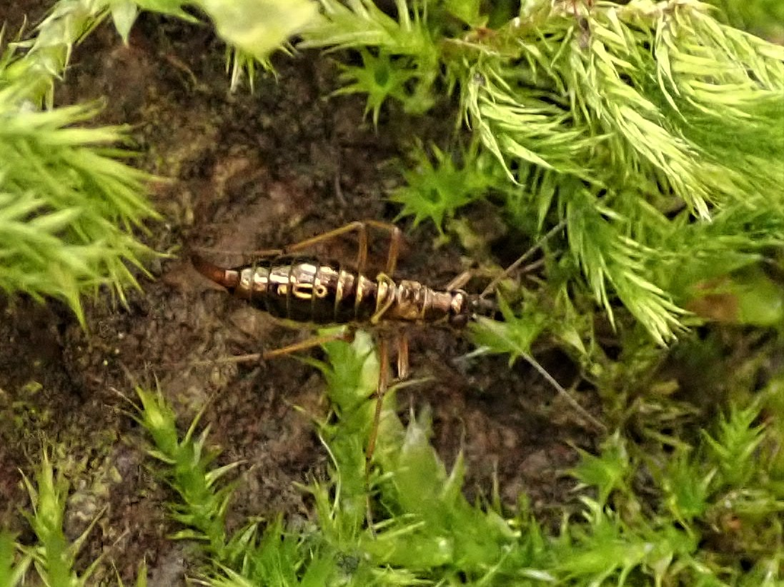
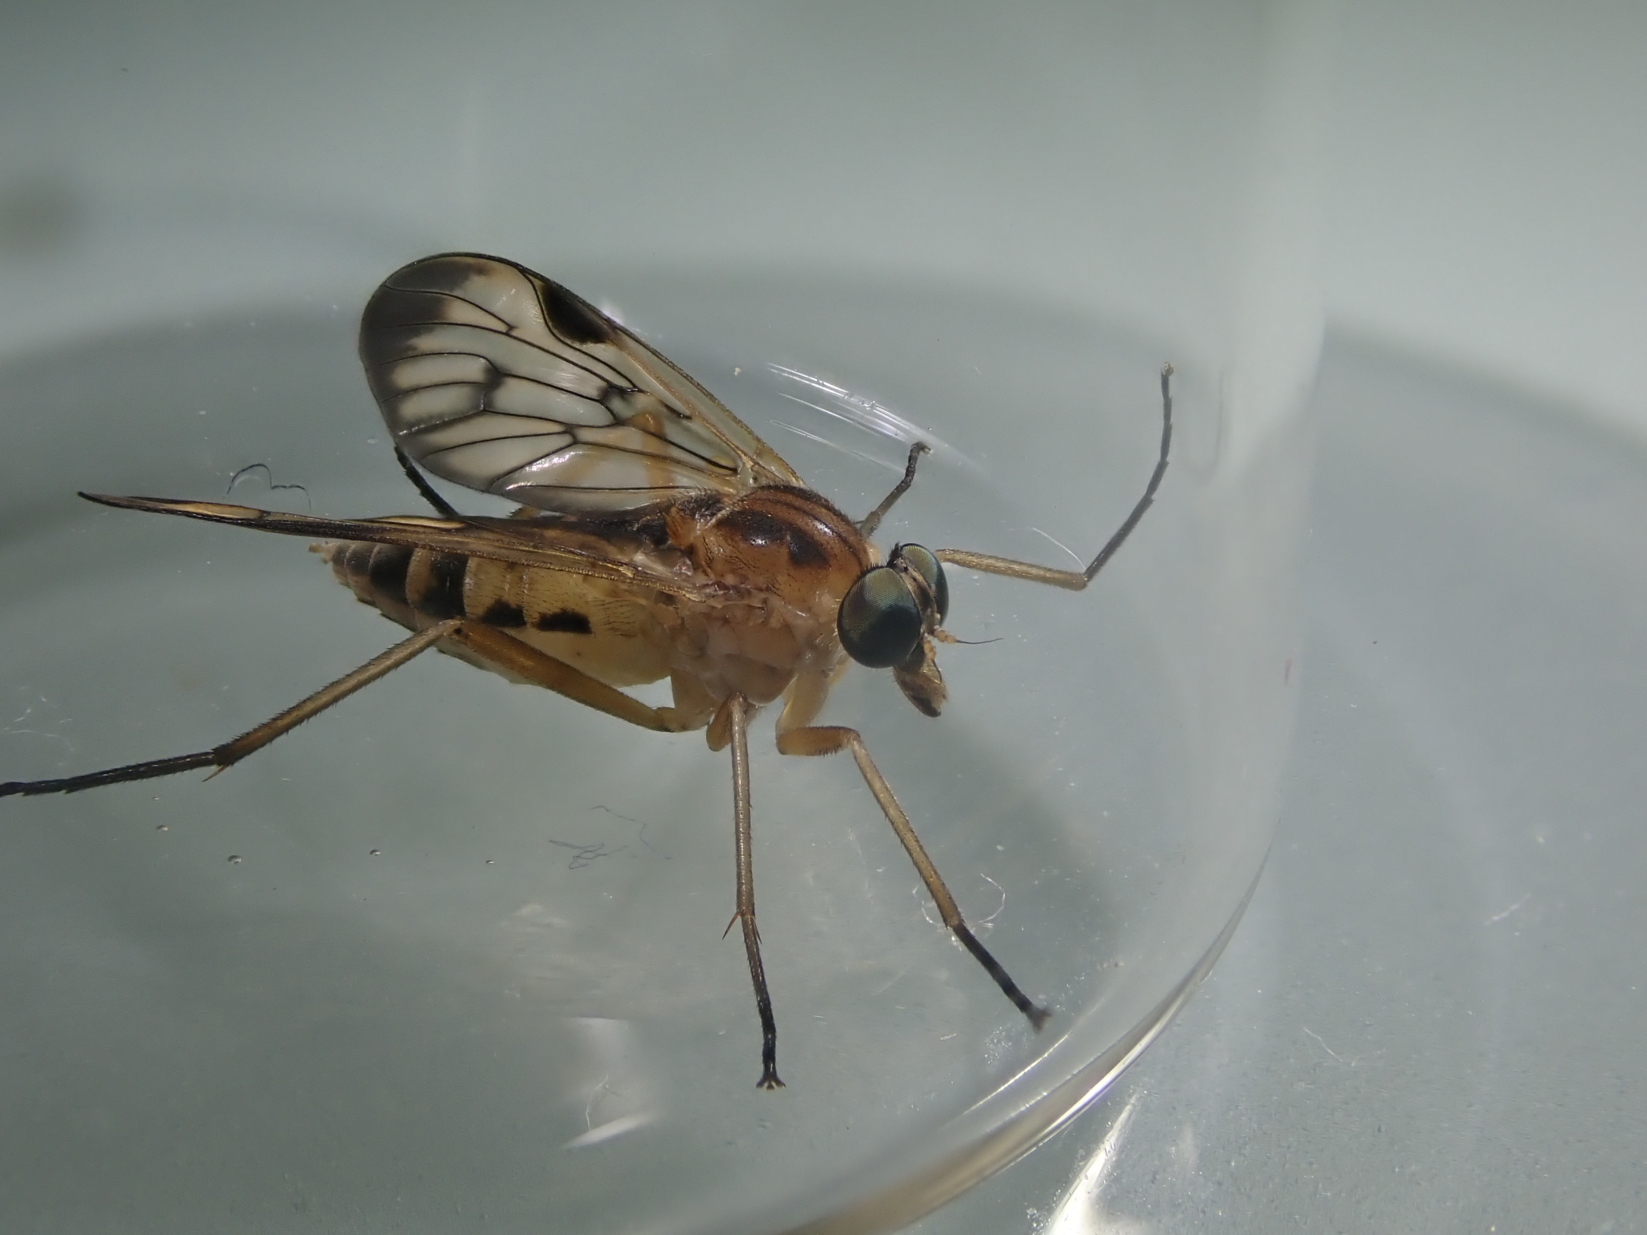
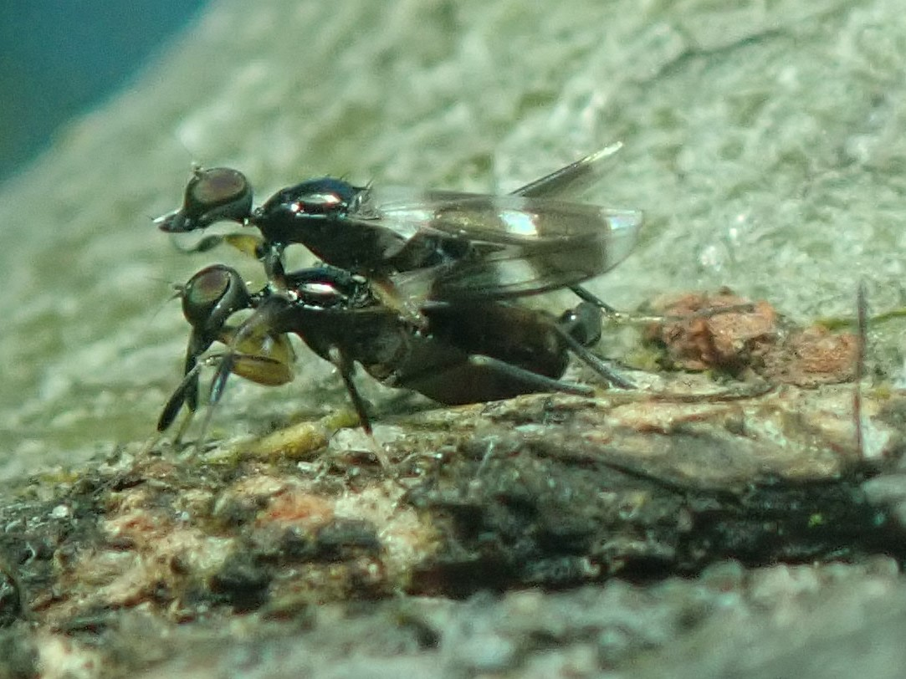
Recording & Surveying
I record wherever and whenever I can.
Since Nov 2019 I have made over 22,000 records from 2,277 species.
I am involved in a range of transects, surveys and single species studies. Including Downland Plume Moth once thought extinct in the UK.
Inevitably I have been delighted to find species that are Nationally Notable or are first county records.
These include
The Snow Flea Boreas hyemalis
Yellow Downlooker Fly Rhagio strigosus
Tachydromia smithi a tiny Empid fly
Snow flea
(5mm) female
Yellow Down-looker fly
(10-12mm) female
Tachydromia smithi a tiny predatory fly (3mm) in cop
Some first county records for Bucks

Slide 3
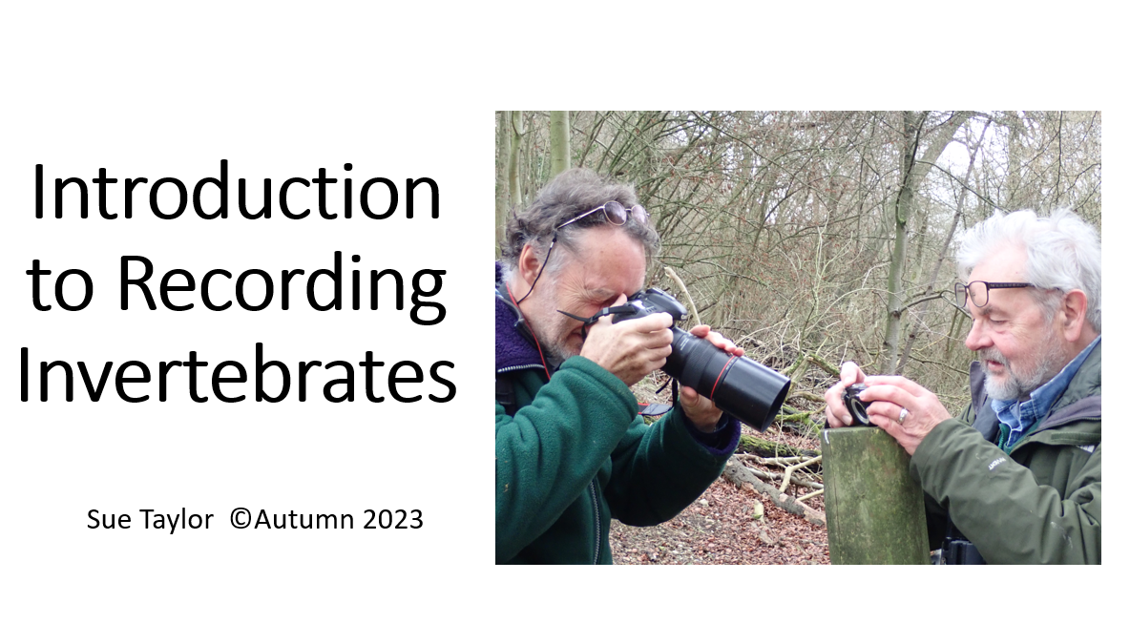
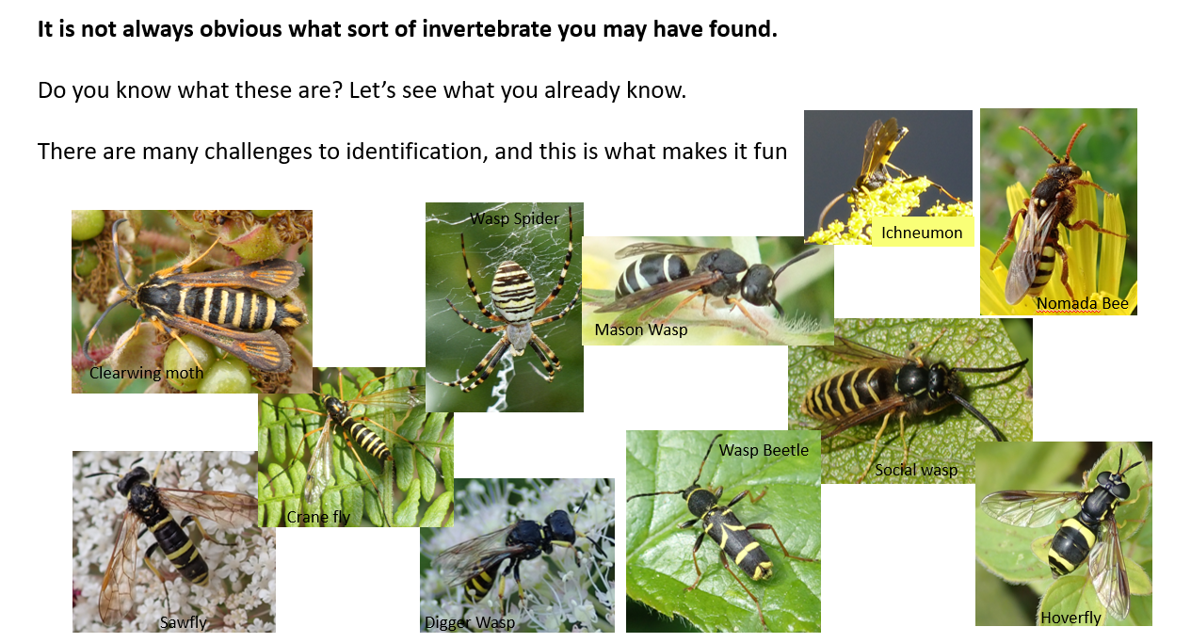
Teaching
When I received my award, I was already teaching a course called
‘Introduction to Recording Invertebrates’.
Post Covid this has continued.
I will continue to teach as we need to do all we can to engage new recorders, enthusing and enabling them to confidently make accurate records.

Slide 4
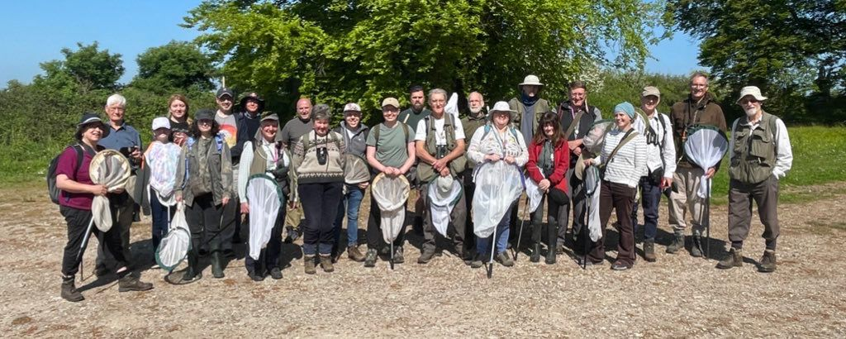
Associations
I am now on the Council of The British Entomological and Natural History Society.
A committee member of my local Butterfly Conservation Group
Regular surveyor and walk leader for BBOWT
Active member of the Dipterists Forum
Active member of The Bucks Invertebrate Group
Through all these there are opportunities to engage with people and encourage them to learn about and record invertebrates; opportunities for me to learn too.
me
Dipterist Spring meeting 2023 Wiltshire
A great bunch of people to help hone your skills

Slide 5
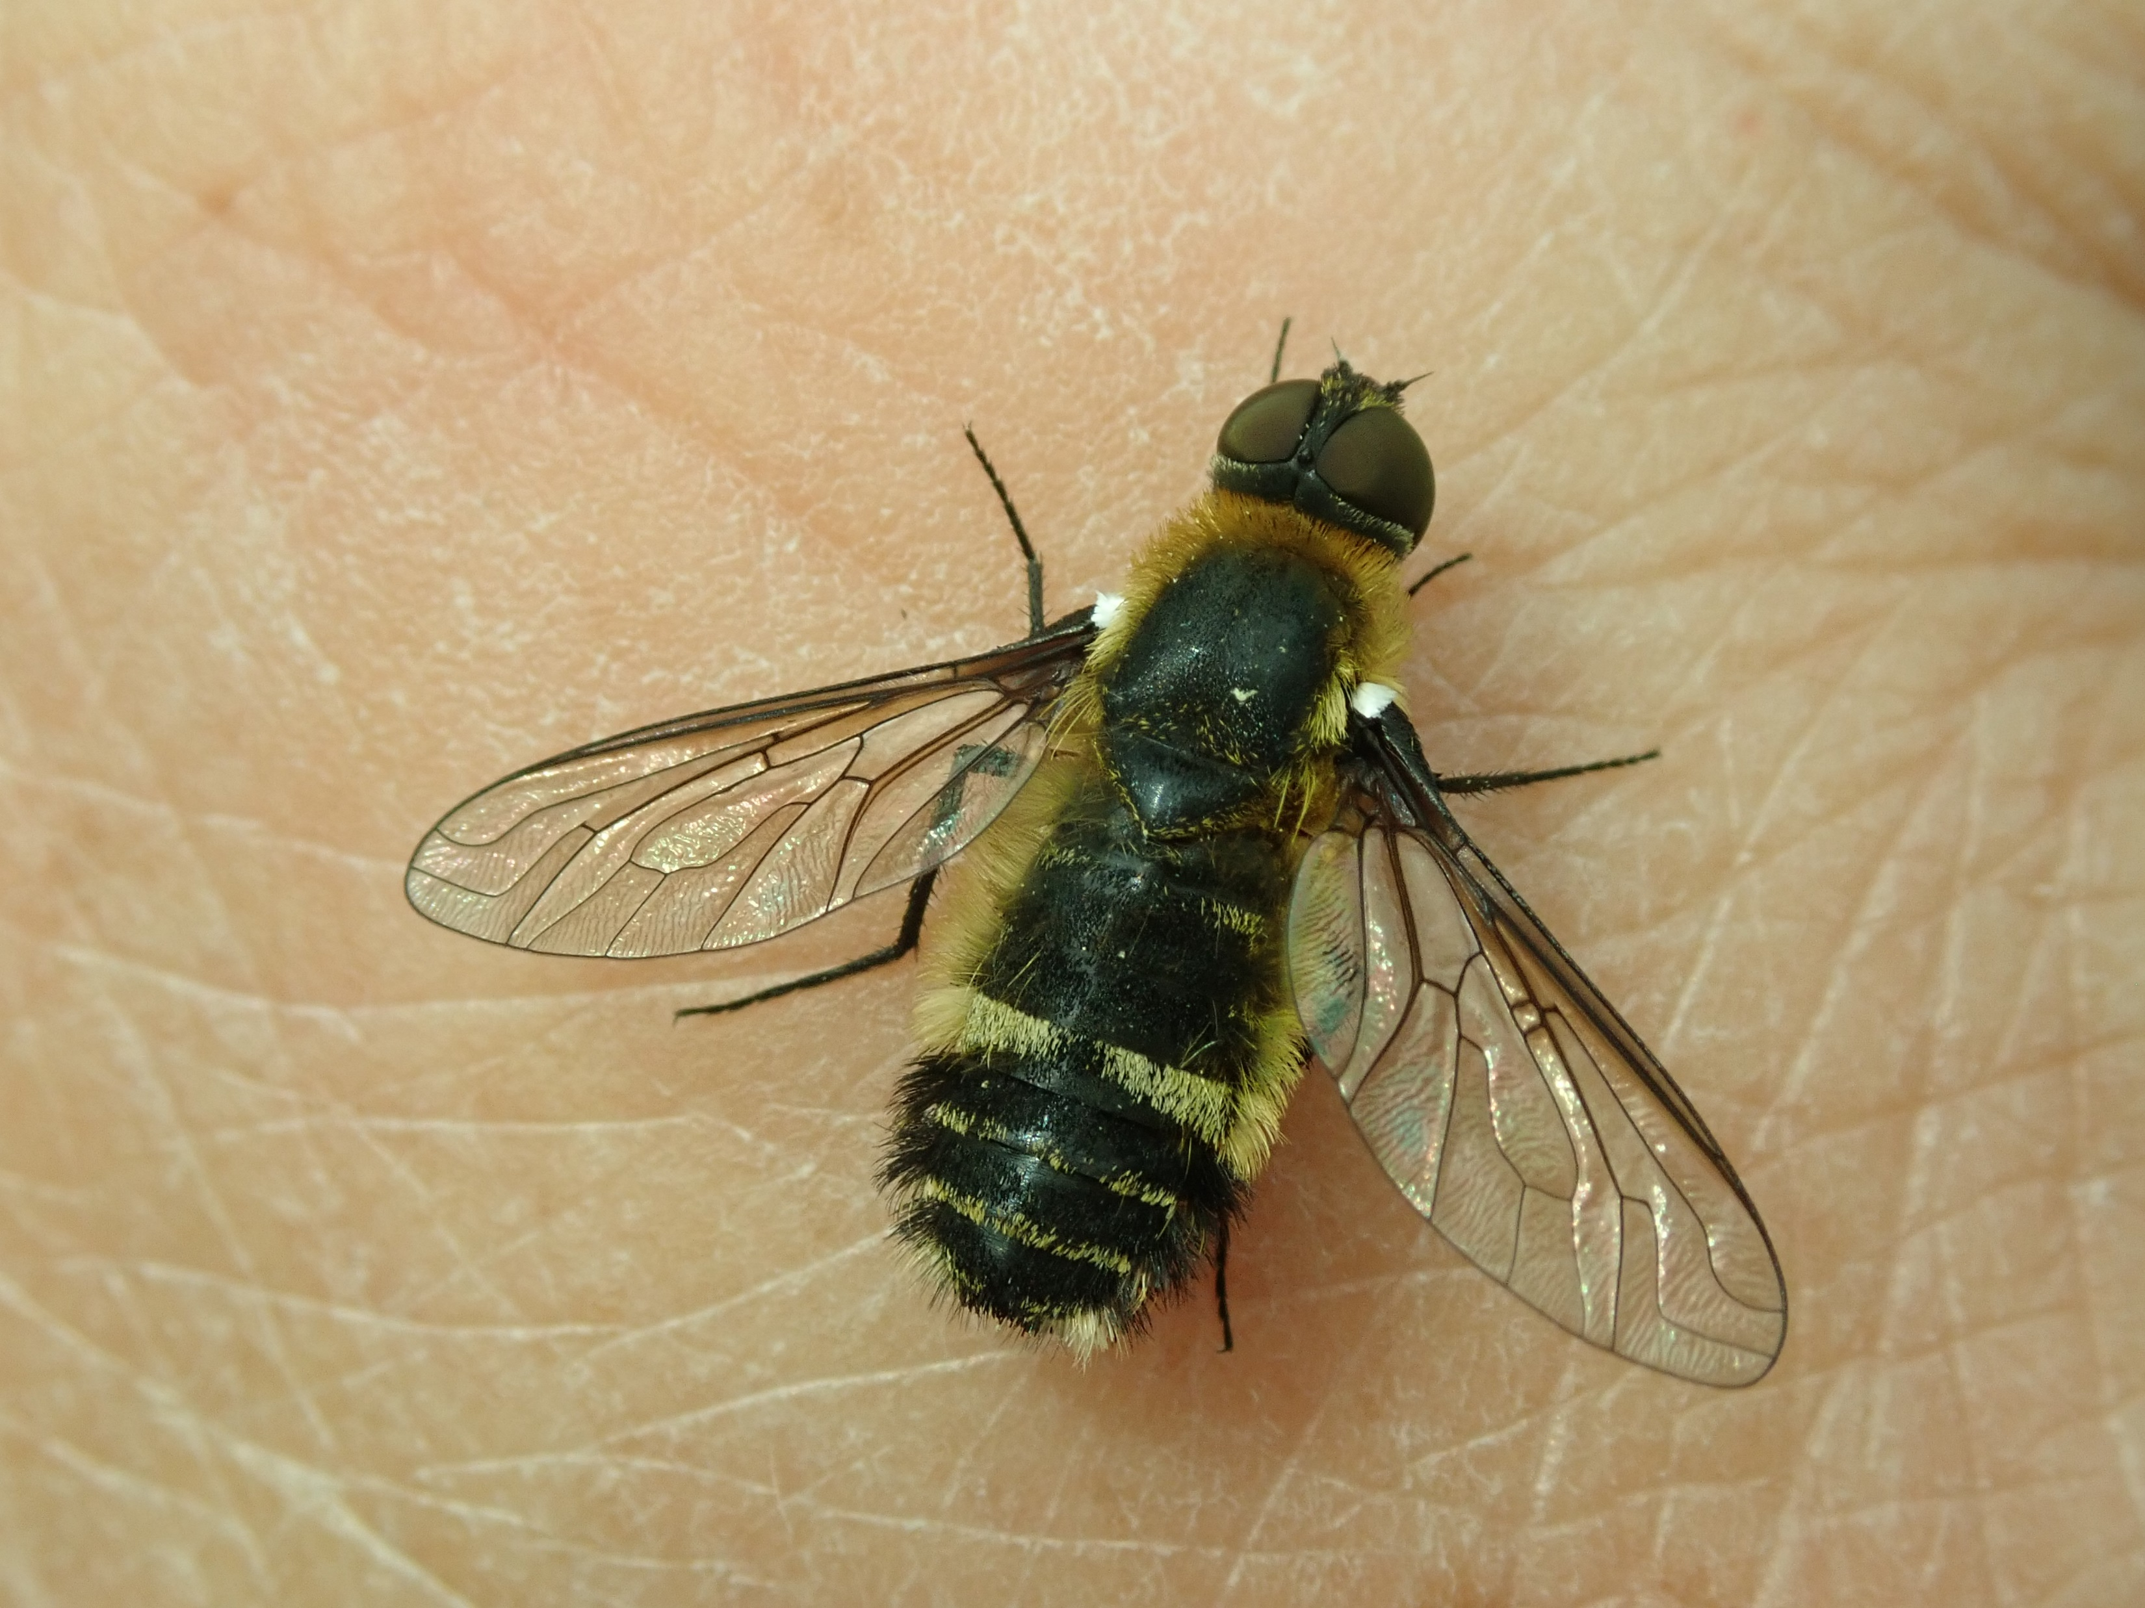
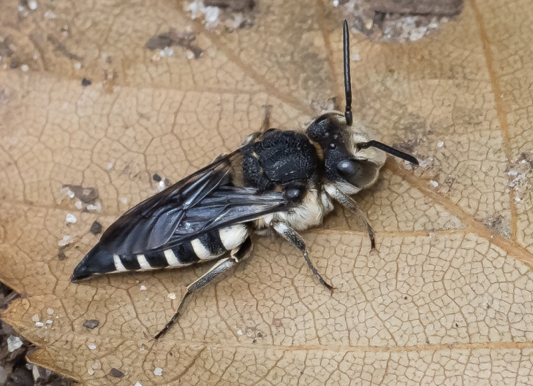
Darwin Tree of Life Project
I was introduced to this project by the Dipterists forum, the project seeks to map the genome of every UK species.
I dislike killing insects, preferring to photograph them.
But I realise that a small number of each species will need to be collected if we are to find technologies that might make collecting less necessary in the future.
Because I survey sites for a variety of organisations, I was able to collect on many sites.
As a pan-lister I could collect across many taxa, including flies, bugs, bees, spiders, snails and beetles.
I understand that I am one of the most regular contributors across the invertebrate taxa to the scheme.
I have already co-authored two genome notes *and I am likely to write up to 30 more.
*descriptions of the insect which has had its DNA sequenced
Downland Villa
©John Curd from iRec
Large Sharp-tailed bee
Two species I have collected and
co-authored genome notes for.

